Slide 1
Lecture Notes
Binomial Distribution
Prof. Welz, Gary
OER – www.helpyourmath.com

Slide 2
The Binomial Distribution
When you toss dice or a coin the set of all outcomes has what we call a binomial distribution
When each trial of an experiment, like tossing dice or coins, has exactly two possible outcomes, call them success and failure, then the probability of any combination of successes and failures can be represented by the following formula
$$P\left(x successes in n trials of a binomial experiment\right)$$
$$=C\left(n,x\right)(p^{x})({1−p)}^{n−x}$$
Sometimes written as
$${}_{n}C_{x}(p^{x})({1−p)}^{n−x}$$
Where $C\left(n,x\right)$ or ${}_{n}C_{x}$represent the number of combinations of n things taken x at a time, p represents the probability of success on a single trial and 1-p represents its compliment, i.e. probability of failure on a single trial.

Slide 3
Example 1: Exactly 2 heads in 3 tosses
What is the probability of tossing a coin three times and getting exactly two heads?
If we consider getting a head to be success, then getting a tail is failure.
We let n=3 and x=2 because we are tossing the coin three times and getting exactly two heads.
The number of combinations of 3 things taken 2 at a time is given by the formula
$$\frac{n!}{\left(n−x\right)!·x!}= \frac{3!}{\left(3−2\right)!·2!}=\frac{6}{1·2}=3$$
Since heads and tails are equally likely, p=0.5 and 1-p=1-0.5=0.5

Slide 4
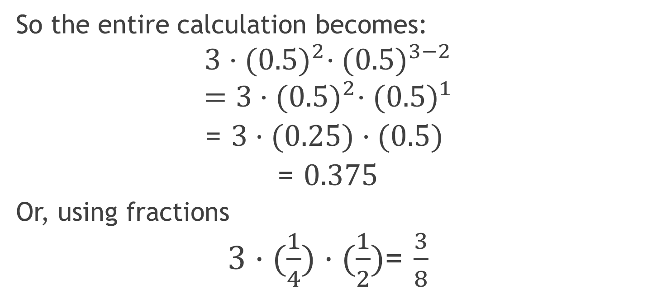
Example 1: Exactly 2 heads in 3 tosses continued
So the entire calculation becomes:
$$3·{(0.5)}^{2}·{(0.5)}^{3−2}$$
$$=3·{(0.5)}^{2}·{(0.5)}^{1}$$
= $3·(0.25)·(0.5)$
= $0.375$
Or, using fractions
$3·(\frac{1}{4})·(\frac{1}{2})$= $\frac{3}{8}$

Slide 5
How many possible outcomes are there?
The 4 possible outcomes are:
0 heads and 3 tails
1 head and 2 tails
2 heads and 1 tail
3 heads and 0 tails

Slide 6
Example 2: Exactly 0 heads in 3 tosses
Here’s another case. What is the probability of tossing a coin three time and getting zero heads?
Again, we consider getting a head to be success and getting a tail is failure.
We let n=3 and x=0 because we are tossing the coin three times and getting exactly two heads.
The number of combinations of 3 things taken 0 at a time is given be the formula
$$\frac{n!}{\left(n−x\right)!·x!}= \frac{3!}{\left(3−0\right)!·0!}=\frac{6}{6·1}=1$$
Remember, 0! Is defined to be equal to 1.

Slide 7
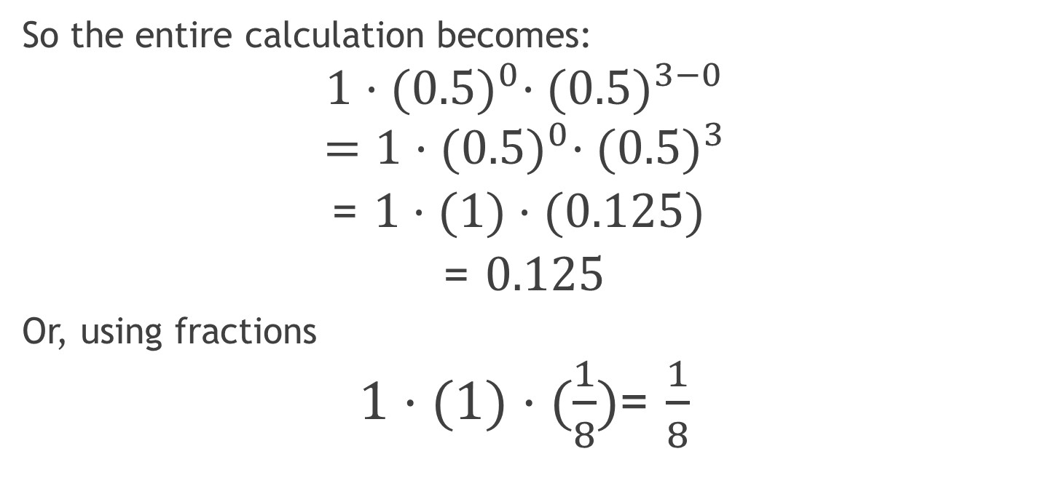
Example 2: Exactly 0 heads in 3 tosses continued
So the entire calculation becomes:
$$1·{(0.5)}^{0}·{(0.5)}^{3−0}$$
$$=1·{(0.5)}^{0}·{(0.5)}^{3}$$
= $1·(1)·(0.125)$
= $0.125$
Or, using fractions
$1·(1)·(\frac{1}{8})$= $\frac{1}{8}$

Slide 8
Probability Distribution for Tossing 3 coins
Number of heads | Probability
0 | 1/8 or 0.125 = 12.5%
1 | 3/8 or 0.375 = 37.5%
2 | 3/8 or 0.375 = 37.5%
3 | 1/8 or 0.125 = 12.5%

Slide 9
Histogram for the Binomial Distribution of tossing 3 coins.

Slide 10
What about getting “at least” or “at most” a certain number of heads?
We can think of getting “At least two heads in three tosses” as equivalent to getting exactly two heads or exactly three heads. To calculate these probabilities you simply calculate the probability of each of the possible alternatives and add them together. For example
P(At least two heads in three tosses)
= P(Exactly 2 heads in three tosses) + P(Exactly 3 heads in three tosses)
$$=\frac{3}{8}+\frac{1}{8}=\frac{1}{2}=0.5$$
Similarly, “At most two heads in three tosses would be equivalent to getting zero heads, one head or two heads.
P(At most two heads in three tosses)
= P(Exactly 0 heads in 3) + P(Exactly 1 head in 3) + P(Exactly 2 heads in 3)
$$=\frac{1}{8}+\frac{3}{8}+\frac{3}{8}=\frac{7}{8}=0.875$$

Slide 11
What about when success and failure are not equally likely?
When we toss a 6-sided die, the probability of any one of the six faces showing up is $\frac{1}{6}$. So the value of the probability of success, p would be $\frac{1}{6}$, but the probability of failure, denoted by 1-p, would be 1-$(\frac{1}{6}$) = $\frac{5}{6}$.
Consequently, the probability of getting exactly one #1 (or any other single number) when you roll a die two times would be.
$=C\left(2,1\right)·({\frac{1}{6})}^{1}·({\frac{5}{6})}^{2−1}$
=$\frac{2!}{\left(2−1\right)!·1!}·$($\frac{1}{6})·(\frac{5}{6}$)
=2·$(\frac{5}{36}$) = $\frac{10}{36}$ = $\frac{5}{18}$

